Slide 1
Integrasi RASA Framework dengan External API Services
atjahyanto@gmail.com

Slide 2
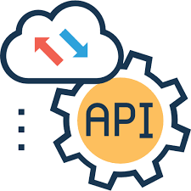

Integrasi RASA Framework dengan External API Services
Agar RASA dapat berkomunikasi dengan layanan eksternal melalui API.
Contoh layanan eksternal:
Akademik: Menampilkan transkrip nilai, jadwal kuliah, status pembayaran.
E-commerce: Mengecek status pesanan, stok barang, harga terbaru.
Perjalanan: Mengecek tiket pesawat/kereta, jadwal keberangkatan.
Informasi umum: Cuaca, berita terkini, kurs mata uang.
request
response

Slide 3

External API Services
Layanan eksternal yang menyediakan Application Programming Interface (API) agar aplikasi lain bisa berkomunikasi, bertukar data, atau menggunakan fitur tertentu tanpa harus membangun semuanya dari nol.
Menggunakan protokol HTTP/HTTPS dengan format data JSON atau XML, sehingga mudah diakses lintas platform.

Slide 4
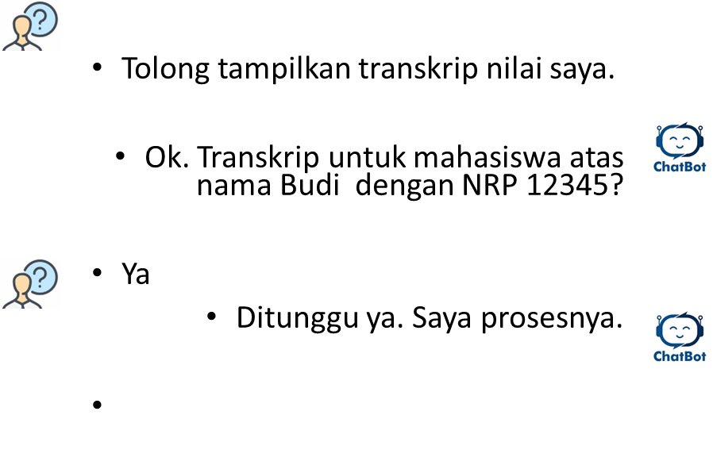

Contoh Skenario pada Chatbot Akademik
User bertanya: “Tolong tampilkan transkrip nilai saya.”
RASA mengenali intent → minta_transkrip.
Custom Action di RASA memanggil API eksternal (misalnya NodeJS + MySQL) yang menyediakan data nilai.
API mengembalikan data JSON (daftar mata kuliah dan nilai).
RASA menampilkan hasil ke user dalam format natural language.

Slide 5
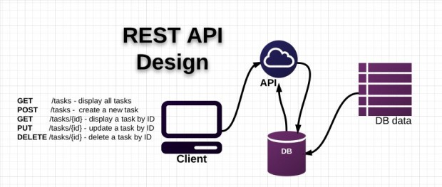
API Services

Slide 6
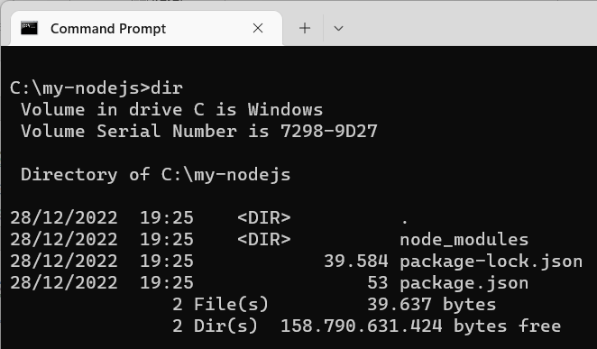
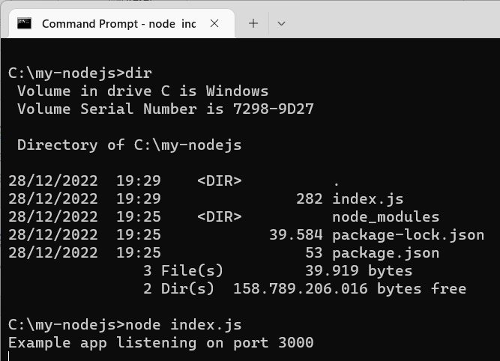
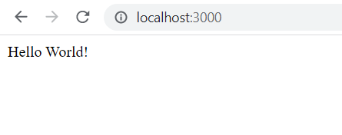
index.js
NodeJS Rest API
// from browser type : http://localhost:3000/
const express = require('express')
const app = express()
const port = 3000
app.get('/', (req, res) => {
res.send('Hello World!')
})
app.listen(port, () => {
console.log(`Example app listening on port ${port}`)
})
Git Bash or CMD:
$ mkdir my-nodejs
$ cd my-nodejs
$ npm install express
Tes hello world :
$ node index.js
‘/hello’

Slide 7
Create database & table
CREATE TABLE mahasiswa(
nrp INT(11) PRIMARY KEY NOT NULL,
mhs_name VARCHAR(30),
mhs_addr VARCHAR(80)
)ENGINE=INNODB;
INSERT INTO mahasiswa(nrp,mhs_name, mhs_addr) VALUES
(5211,'Adi Husada','Jl Mangga 123 Surabaya'),
(5222,'Budi Santosa', 'Jl Nanas 54 Surabaya'),
(5233,'Edi Darmadi','Jl. Pangsud 2A Surabaya'),
(5244,'Farida Pasha','Jl. Gatsu 65 Surabaya'),
(5255,'Gigih Perkasa','Jl. ARH 73 Surabaya');
Install XAMPP
Start Apache
Start MySQL
Akses ke http://localhost/phpmyadmin/
Create db, misal: cobadb
dst

Slide 8
Create table
CREATE TABLE transkrip (
id INT AUTO_INCREMENT PRIMARY KEY,
nrp INT(11),
mata_kuliah VARCHAR(100),
nilai CHAR(2)
);
INSERT INTO transkrip (nrp, mata_kuliah, nilai) VALUES
(5211, 'Algoritma dan Struktur Data', 'A'),
(5211, 'Basis Data', 'B+'),
(5211, 'Kecerdasan Buatan', 'A-'),
(5222, 'Algoritma dan Struktur Data', 'AB'),
(5222, 'Basis Data', 'AB'),
(5222, 'Kecerdasan Buatan', 'AB');

Slide 9
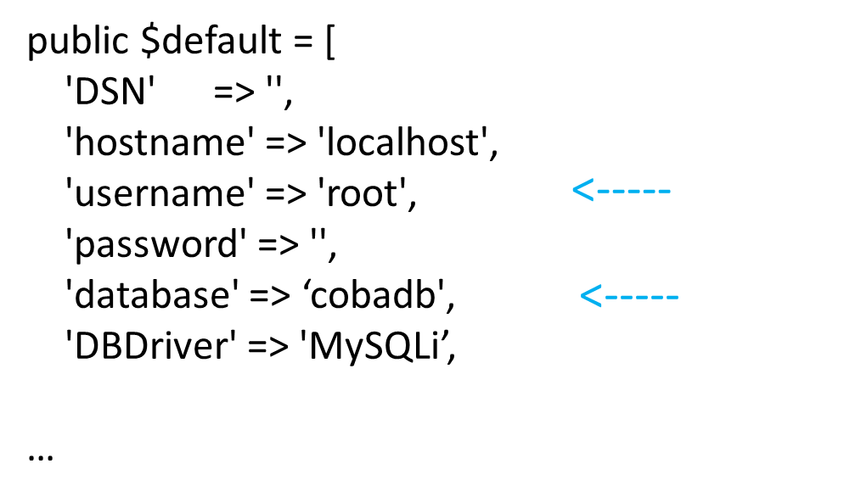

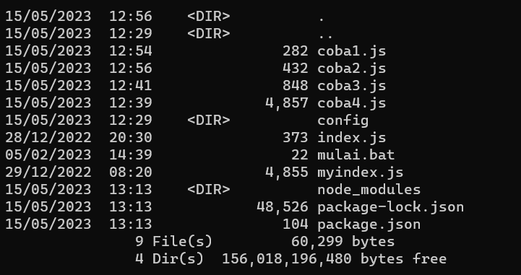
Configure database connection
Create a directory:
$ mkdir config
$ cd config
Create a database.js file in the folder
database.js
const mysql = require('mysql');
// buat konfigurasi koneksi
const koneksi = mysql.createConnection({
host: 'localhost',
user: 'root',
password: '',
database: 'cobadb',
multipleStatements: true
});
// koneksi database
koneksi.connect((err) => {
if (err) throw err;
console.log('MySQL Connected...');
});
module.exports = koneksi;
Jika COPAS dari PPT ini, mungkin terjadi perubahan tanda petik yang menyebabkan error.

Slide 10
API services
3
my-API-transkrip.js
const express = require('express');
const bodyParser = require('body-parser');
const app = express();
const port = 4000;
// Koneksi database
const db = require('./config/database');
// Endpoint untuk transkrip
app.get('/transkrip/:nrp', (req, res) => {
const nrp = req.params.nrp;
db.query('SELECT mata_kuliah, nilai FROM transkrip WHERE nrp = ?', [nrp], (err, results) => {
if (err) return res.status(500).json({ error: err });
res.json(results);
});
});
app.listen(port, () => {
console.log(`API berjalan di http://localhost:${port}`);
});
$ node my-API-transkrip.js
Uji dengan Postman:
GET
http://localhost:4000/transkrip/5211

Slide 11
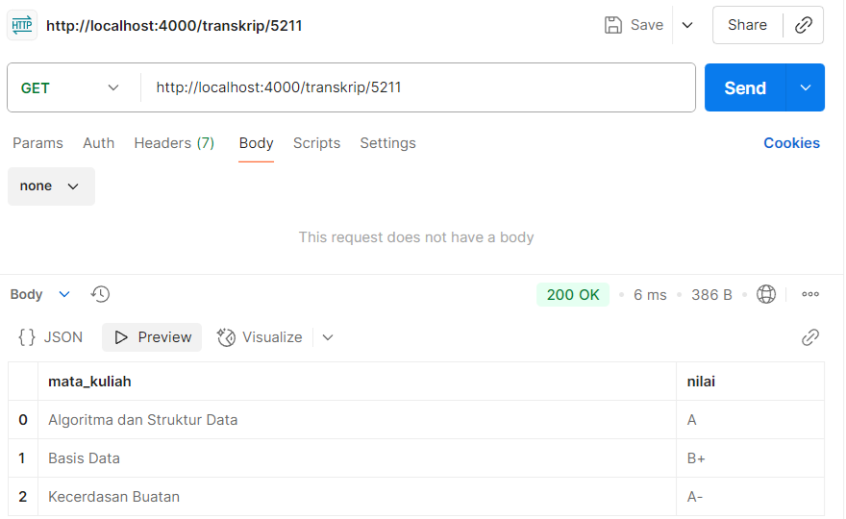
Hasil uji coba dengan Postman
Uji dengan Postman:
GET
http://localhost:4000/transkrip/5211

Slide 13
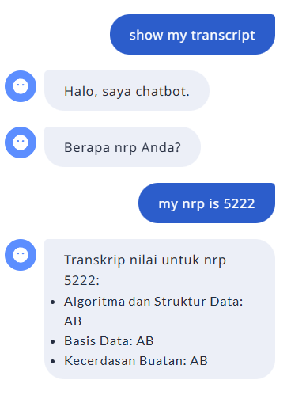
Contoh Skenario
2
Chatbot
data/stories.yml
#--------------------------------------
- story: tanya transkrip
steps:
- intent: minta_transkrip
- action: utter_greet
- action: utter_ask_nrp
- intent: provide_nrp
- action: minta_transkrip_action

Slide 14
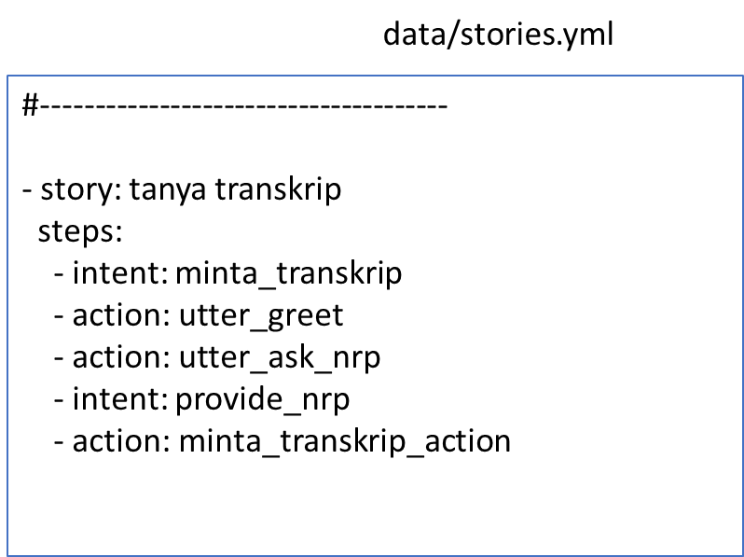
Custom Action di RASA (actions/actions.py)
File actions/actions.py berisi custom actions dalam bentuk kode Python.
Action ini dijalankan ketika chatbot perlu melakukan sesuatu di luar jawaban statis
from typing import Any, Text, Dict, List
from rasa_sdk import Action, Tracker
from rasa_sdk.executor import CollectingDispatcher
import requests
class ActionGetTranskrip(Action):
def name(self) -> Text:
return "minta_transkrip_action"
def run(self, dispatcher: CollectingDispatcher,
tracker: Tracker,
domain: Dict[Text, Any]) -> List[Dict[Text, Any]]:
print ("Masuk ke ActionGetTranskrip")
nrp = tracker.get_slot("nrp") # Slot dari user
response = requests.get(f"http://localhost:4000/transkrip/{nrp}")
if response.status_code == 200:
data = response.json()
if len(data) == 0:
dispatcher.utter_message(text="Transkrip tidak ditemukan.")
else:
msg = f"Transkrip nilai untuk nrp {nrp}:\n"
for item in data:
msg += f"- {item['mata_kuliah']}: {item['nilai']}\n"
dispatcher.utter_message(text=msg)
else:
dispatcher.utter_message(text="Gagal mengambil data transkrip.")
return []

Slide 15
Domain File (domain.yml)
version: "3.1"
intents:
- greet
- provide_name
- provide_nrp
- goodbye
- mood_great
- minta_transkrip
entities:
- name
- nrp
slots:
name:
type: text
influence_conversation: true
mappings:
- type: from_entity
entity: name
#--------
File domain.yml digunakan mendefinisikan intent, entity, slot, response, action

Slide 16
Menyiapkan Percakapan Sederhana
Jangan lupa hapus dulu file flows.yml
version: "3.1"
nlu:
- intent: greet
examples: |
- halo
- hi
- selamat pagi
- hai
- intent: goodbye
examples: |
- cu
- good by
- cee you later
- good night
- bye
- goodbye
- have a nice day
- see you around
- bye bye
- see you later
- intent: provide_name
examples: |
- Nama saya [Aris](name)
- Saya [Budi](name)
- Panggil saya [Citra](name)
- Saya bernama [Dewi](name)
- [Andi](name) adalah nama saya
- intent: provide_nrp
examples: |
- NRP saya adalah [5211](nrp)
- Saya [5211](nrp)
- NRP saya [5211](nrp)
- Saya punya NRP [5211](nrp)
- [5211](nrp) adalah NRP saya
- intent: mood_great
examples: |
- perfect
- great
- amazing
- feeling like a king
- wonderful
- I am feeling very good
- I am great
- I am amazing
- super stoked
- extremely good
- so so perfect
- so good
- so perfect
- intent: minta_transkrip
examples: |
- show my transcript,
- give me my transcript,
- show transcript,
- please show my grades,
- show the transcript
version: "3.1"
stories:
- story: perkenalan sederhana dengan stories
steps:
- intent: greet
- action: utter_greet
- action: utter_ask_name
- intent: provide_name
- action: utter_confirm
- story: amazing dan tanya nrp
steps:
- intent: mood_great
- action: utter_greet
- action: utter_ask_nrp
- intent: provide_nrp
- action: utter_confirm_nrp
- story: tanya transkrip
steps:
- intent: minta_transkrip
- action: utter_greet
- action: utter_ask_nrp
- intent: provide_nrp
- action: minta_transkrip_action
version: "3.1"
intents:
- greet
- provide_name
- provide_nrp
- goodbye
- mood_great
- minta_transkrip
entities:
- name
- nrp
slots:
name:
type: text
influence_conversation: true
mappings:
- type: from_entity
entity: name
nrp:
type: text
influence_conversation: true
mappings:
- type: from_entity
entity: nrp
responses:
utter_greet:
- text: "Halo, saya chatbot."
utter_confirm:
- text: "Ok {name}"
utter_confirm_nrp:
- text: "Ok nrp Anda adalah {nrp}"
utter_ask_name:
- text: "Siapa nama Anda?"
utter_ask_nrp:
- text: "Berapa nrp Anda?"
utter_name_received:
- text: "Senang bertemu denganmu, {name}!"
utter_goodbye:
- text: Bye
- text: Nice chatting with you!! Bye bye!!
- text: See ya!!
utter_restart:
- text: Is there anything else that I can help you with?
- text: Do you have any other query?
actions:
- utter_greet
- utter_restart
- utter_ask_name
- utter_ask_nrp
- utter_confirm
- minta_transkrip_action
- utter_name_received
session_config:
session_expiration_time: 60
carry_over_slots_to_new_session: true
version: "3.1"
rules:
- rule: Say goodbye anytime the user says goodbye
steps:
- intent: goodbye
- action: utter_goodbye
data/rules.yml
recipe: default.v1
language: "en"
# -------------------------
# NLU Pipeline
# -------------------------
pipeline:
- name: NLUCommandAdapter # adapter ditambahkan di sini
url: "http://localhost:3000"
# -------------------------
# Dialogue Policies
# -------------------------
policies:
- name: MemoizationPolicy
- name: TEDPolicy
max_history: 10
epochs: 200
- name: RulePolicy
assistant_id: 20250924-045037-leather-model
domain.yml
data/nlu.yml
data/stories.yml
config.yml

Slide 17
File config.yml
1
Intent & Entity recognizer
from flask import Flask, request, jsonify
from transformers import pipeline
import re
app = Flask(__name__)
ner_pipeline = pipeline("ner", model="dslim/bert-base-NER", aggregation_strategy="simple")
def hybrid_entity_recognition(text):
# 1. BERT-based NER
bert_entities = ner_pipeline(text)
# Standardisasi key dari BERT ke format seragam
standardized_bert_entities = [
{
"entity": ent["entity_group"],
"word": ent["word"],
"score": ent["score"],
"start": ent["start"],
"end": ent["end"],
}
for ent in bert_entities
]
# 2. Regex-based NER
regex_patterns = {
"EMAIL": r"[a-zA-Z0-9._%+-]+@[a-zA-Z0-9.-]+\.[a-zA-Z]{2,}",
"PHONE": r"\+?\d{1,3}[-\s]?\d{3}[-\s]?\d{3}[-\s]?\d{4}",
"DATE": r"\b\d{1,2}[/-]\d{1,2}[/-]\d{2,4}\b",
"URL": r"https?://[^\s]+",
"NRP": r"\b52\d+\b"
}
regex_entities = []
for label, pattern in regex_patterns.items():
for match in re.finditer(pattern, text):
regex_entities.append({
"entity": label,
"word": match.group(),
"score": 1.0, # Regex tidak pakai probabilitas
"start": match.start(),
"end": match.end(),
})
# 3. Gabungkan hasil BERT + Regex
all_entities = standardized_bert_entities + regex_entities
return all_entities
#============================================
from transformers import BertTokenizer, BertForSequenceClassification
import torch
import pickle
def load_intent_model(model_path="my_intent_model"):
"""Load model, tokenizer, dan label encoder."""
model = BertForSequenceClassification.from_pretrained(model_path)
tokenizer = BertTokenizer.from_pretrained(model_path)
with open(f"{model_path}/label_encoder.pkl", "rb") as f:
label_encoder = pickle.load(f)
model.eval()
return model, tokenizer, label_encoder
def get_intent(text, model, tokenizer, label_encoder, entity_list, modtext):
"""Prediksi intent dari input text."""
inputs = tokenizer(modtext, return_tensors="pt", truncation=True, padding=True)
with torch.no_grad():
outputs = model(**inputs)
probs = torch.nn.functional.softmax(outputs.logits, dim=-1)
pred_idx = torch.argmax(probs, dim=1).item()
intent_name = label_encoder.inverse_transform([pred_idx])[0]
confidence = probs[0][pred_idx].item()
if (text=='/session_start'):
intent_name = 'session_start'
confidence = '1.0'
return {
"intent": {
"name": intent_name,
"confidence": float(confidence)
},
"entities": entity_list,
"text": text,
"modtext": modtext
}
model, tokenizer, label_encoder = load_intent_model("my_intent_model")
def replace_entity(text, entity_value, placeholder):
# Escape entity_value biar aman kalau ada karakter khusus (seperti . atau @)
pattern = re.escape(entity_value)
return re.sub(pattern, placeholder, text)
def get_intent_and_entity(text):
entities = hybrid_entity_recognition(text)
entity_list = []
modtext = text
for ent in entities:
entity_type = ent['entity']
entity_typex = entity_type
# value dari entity_typex harus sama dengan slot pada domain.yml
if (entity_type=='PER'):
entity_typex = 'name'
if (entity_type=='NRP'):
entity_typex = 'nrp'
my_entity = {'value': ent['word'], 'entity': entity_typex}
entity_list.append(my_entity)
# modtext adalah user_input yang digunakan untuk prediksi intent
if (entity_type=='NRP'):
modtext = replace_entity(text, ent['word'], "<nrp>")
if (entity_type=='EMAIL'):
modtext = replace_entity(text, ent['word'], "<email>")
if (entity_type=='PER'):
modtext = replace_entity(text, ent['word'], "<name>")
#print(f"{ent['word']:<30} --> {ent['entity']} (start={ent['start']}, end={ent['end']})")
hasil = get_intent(text, model, tokenizer, label_encoder, entity_list, modtext)
return hasil
@app.route("/model/parse", methods=["POST"])
def parse():
data = request.get_json()
user_input = data.get("text", "")
print(f"Text: {user_input}")
# Return RASA-style response
response = get_intent_and_entity(user_input)
print (response)
return jsonify(response)
if __name__ == "__main__":
app.run(host="0.0.0.0", port=3000)
import torch
import pandas as pd
import numpy as np
import torch.nn as nn
from torch.utils.data import DataLoader, Dataset
from transformers import BertTokenizer, BertForSequenceClassification
from sklearn.model_selection import train_test_split
from sklearn.preprocessing import LabelEncoder
from sklearn.metrics import accuracy_score, classification_report
import matplotlib.pyplot as plt
bertModel = 'bert-base-uncased'
bertModel = 'distilbert-base-uncased'
n_epochs = 10
# Load the dataset
# ====== Dataset ======
data = {
"text": [
# greet
"hallo", "hello", "hi", "good morning",
"hey dude", "good afternoon",
# goodbye
"good bye", "cee you later", "byebye","goodbye", "bye bye", "see you later",
# affirm
"yes", "yeah", "indeed", "of course", "that sounds good", "correct",
# deny
"no", "not", "never", "don't like that", "no way", "not really",
# mood_great
"perfect", "great", "amazing", "wonderful",
"so good", "so perfect",
# mood_unhappy
"my day was horrible", "I am sad", "I don't feel very well", "I am disappointed", "I'm so sad",
# bot_challenge
"are you a bot?", "are you a human?", "am I talking to a bot?", "am I talking to a human?",
# provide_name
"My name is <name>", "I am <name>", "It's <name>", "Name <name>", "It is <name>",
# provide_email
"My email is <email>", "This email <email> is mine", "You can reach me at <email>", "email saya adalah <email>",
# provide_nrp
"My nim is <nrp>", "My nrp is <nrp>", "NRP saya <nrp>", "NRP <nrp>","NIM <nrp>",
# user_regist
"I want to register", "Registration please", "I am a new user",
# show_info
"Show me my registration", "What did I give?", "Review my data",
"show my transcript",
"give me my transcript",
"show transcript",
"please show my grades",
"show the transcript"
],
"label": [
# greet
"greet","greet","greet","greet","greet","greet",
# goodbye
"goodbye","goodbye","goodbye","goodbye","goodbye","goodbye",
# affirm
"affirm","affirm","affirm","affirm","affirm","affirm",
# deny
"deny","deny","deny","deny","deny","deny",
# mood_great
"mood_great","mood_great","mood_great","mood_great","mood_great", "mood_great",
# mood_unhappy
"mood_unhappy","mood_unhappy","mood_unhappy","mood_unhappy","mood_unhappy",
# bot_challenge
"bot_challenge","bot_challenge","bot_challenge","bot_challenge",
# provide_name
"provide_name","provide_name","provide_name","provide_name", "provide_name",
# provide_email
"provide_email","provide_email","provide_email","provide_email",
# provide_nrp
"provide_nrp","provide_nrp","provide_nrp","provide_nrp", "provide_nrp",
# user_regist
"user_regist","user_regist","user_regist",
# show_info
"show_info","show_info","show_info",
# minta_transkrip
"minta_transkrip", "minta_transkrip", "minta_transkrip", "minta_transkrip", "minta_transkrip"
]
}
df = pd.DataFrame(data)
texts = list(df["text"])
labels = df["label"].values
categories = np.unique(labels)
sample_size = len(texts)
num_class = len(categories)
# Encode labels
label_encoder = LabelEncoder()
encoded_labels = label_encoder.fit_transform(labels)
# Split the dataset into train and test sets
X_train, X_test, y_train, y_test = train_test_split(texts, encoded_labels, test_size=0.3, random_state=42)
# Tokenizer and Dataset Class
tokenizer = BertTokenizer.from_pretrained(bertModel)
class myDataset(Dataset):
def __init__(self, texts, labels, tokenizer, max_len=512):
self.texts = texts
self.labels = labels
self.tokenizer = tokenizer
self.max_len = max_len
def __len__(self):
return len(self.texts)
def __getitem__(self, idx):
text = self.texts[idx]
label = self.labels[idx]
encoding = self.tokenizer.encode_plus(
text,
add_special_tokens=True,
truncation=True,
max_length=self.max_len,
return_token_type_ids=False,
padding='max_length',
return_attention_mask=True,
return_tensors='pt'
)
return {
'input_ids': encoding['input_ids'].flatten(),
'attention_mask': encoding['attention_mask'].flatten(),
'label': torch.tensor(label, dtype=torch.long)
}
print ("Prepare the datasets")
# Prepare the datasets
train_dataset = myDataset(X_train, y_train, tokenizer)
test_dataset = myDataset(X_test, y_test, tokenizer)
# DataLoader
train_loader = DataLoader(train_dataset, batch_size=16, shuffle=True)
test_loader = DataLoader(test_dataset, batch_size=16)
print ("Load the BERT model")
# Load BERT model
model = BertForSequenceClassification.from_pretrained(bertModel, num_labels=num_class)
device = torch.device('cuda' if torch.cuda.is_available() else 'cpu')
model.to(device)
print ("Device yang dipakai: ", device)
# Optimizer and loss function
optimizer = torch.optim.Adam(model.parameters(), lr=2e-5)
loss_fn = nn.CrossEntropyLoss()
# save the model
def save_model(model, tokenizer, model_name = "my_intent_model"):
# ====== Save Model and Tokenizer ======
model.save_pretrained(model_name)
tokenizer.save_pretrained(model_name)
import pickle
with open(model_name+"/label_encoder.pkl", "wb") as f:
pickle.dump(label_encoder, f)
return
# Training loop
def train_model(model, train_loader, loss_fn, optimizer, device, epochs=n_epochs):
model.train()
train_losses = []
for epoch in range(epochs):
total_loss = 0
correct_predictions = 0
for batch in train_loader:
input_ids = batch['input_ids'].to(device)
attention_mask = batch['attention_mask'].to(device)
labels = batch['label'].to(device)
optimizer.zero_grad()
outputs = model(input_ids=input_ids, attention_mask=attention_mask)
loss = loss_fn(outputs.logits, labels)
total_loss += loss.item()
_, preds = torch.max(outputs.logits, dim=1)
correct_predictions += torch.sum(preds == labels)
loss.backward()
optimizer.step()
avg_loss = total_loss / len(train_loader)
accuracy = correct_predictions.double() / len(train_loader.dataset)
train_losses.append(avg_loss)
print(f'Epoch {epoch+1}/{epochs}, Loss: {avg_loss}, Accuracy: {accuracy:.4f}')
return train_losses
# Evaluation
def evaluate_model(model, test_loader, device):
model.eval()
all_preds = []
all_labels = []
with torch.no_grad():
for batch in test_loader:
input_ids = batch['input_ids'].to(device)
attention_mask = batch['attention_mask'].to(device)
labels = batch['label'].to(device)
outputs = model(input_ids=input_ids, attention_mask=attention_mask)
_, preds = torch.max(outputs.logits, dim=1)
all_preds.extend(preds.cpu().numpy())
all_labels.extend(labels.cpu().numpy())
print (all_labels)
print (all_preds)
print (type(all_labels))
print (type(all_preds))
accuracy = accuracy_score(all_labels, all_preds)
print(f'Accuracy: {accuracy:.4f}')
print(classification_report(all_labels, all_preds))
return accuracy
# Train the model
train_losses = train_model(model, train_loader, loss_fn, optimizer, device)
save_model(model, tokenizer)
# Evaluate the model
accuracy = evaluate_model(model, test_loader, device)
# Plot training loss
plt.plot(train_losses, label='Training loss')
plt.title('Training Loss over Epochs')
plt.xlabel('Epochs')
plt.ylabel('Loss')
plt.legend()
plt.show()
recipe: default.v1
language: "en"
# -------------------------
# NLU Pipeline
# -------------------------
pipeline:
- name: NLUCommandAdapter # adapter
url: "http://localhost:3000"
# -------------------------
# Dialogue Policies
# -------------------------
policies:
- name: MemoizationPolicy
- name: TEDPolicy
max_history: 10
epochs: 200
- name: RulePolicy
assistant_id: 20250924-045037-leather-model
config.yml
myInterpreter.py
Fine-tuning-myInterpreter.py

